Slide 1
EMPLOYE DATA ANALYSIS USING EXCEL
NAME : SOWMIYA.S
REGISTER NO : 312209510
DEPARTMENT : B.COM BANK MANAGEMENT
INSTITUTE : ANNA ADARSH COLLEGE FOR WOMEN
Notes:
Name

Slide 2
PROJECT SUMMARY
TO SHOWCASE THE EMPLOYEE PERFORMANCE ANALYSIS USING
EXCEL IN A PROPER VIEW

Slide 3
AGENDA
Problem Statement
Project Overview
End Users
Our Solution and Proposition
Dataset Description
Modelling Approach
Result and Discussion
Conclusion

Slide 4
PROBLEM STATEMENT
To analyze and evaluate the performance of employee over the past few years to identify the strength , the area to improve , overall trends that can be helpful for making the startgeic decision to the HR

Slide 5
PROJECT OVERVIEW
Implementation : analyse and visualize the employee performance data to identify the trends , strength , areas to improve , Identify skill gals ,Implement action , Decision-making criteria & Resources allocation
Data Types : Numerical data, textual data & categorical data
Data Correction: Correction of missing value& inconsistencies & remove of duplicate
Data Organization : Structure data in the tabular format
Dashboard : Develop interactive dashboard using excel‘s pivot table and chart to provide a dynamic view of the provided data
Summary : A report that includes key finding, visualization & action able insights.

Slide 6
WHO ARE THE END USERS ?
Business analyst
Accountant
Student & Educator
Data analyst
Project manager
Sales & Marketing professional
Human resources professional
Engineer

Slide 7
OUR SOLUTION AND ITS VALUE PROPOSTION
Conditional formatting : Missing values
Filter : Remove
Formula : Summary
Graph : Data Visualization

Slide 8
DATASET DESCRIPTION
Employee data: Kaggle
Total no . of features : 26
No . Of features : 9
Employee Id : Numerical data
First name : Textual data
Last name: Textual data
Business unit : Textual data
Employee status : Textual data
Employee data : Textual data
Gender code : Textual data
Current Employee rating : Categorical data
Performance level : Textual data
Notes:
Business unit : Textual data
Employee status : Textual data
Employee data : Textual data
Gender code : Textual data
Current Employee rating : Categorical data
Perfirmance level : Textual data

Slide 9
THE WOW IN OUR SOLUTION
Interactive Dashboard: Creating of the dynamic dashboard with Excel’s Pivot table (slicers interactive charts ) . Which allows the stakeholders to go through the data effortlessly.
Automated Reporting: Use of excel helps in automate report . This help in using of resources effectively and efficiently .
Employee Growth Trajectory Visualization: Build performance and growth Chart for each employee to show their growth over the time . It encourage the employees by showing their development and provides the manager a clear understanding of their overall performance
The wow factor: The WOW is where the solutions lies of transforming the raw data to insightful and interactive performance analysis that makes easy to make decision, encourage & motivate the employee & drive continues growth across the organization.

Slide 10
MODELLING
Define Key Performance Indicator (KPIs)
Identify Metric : Determine the KPIs that reflect employee performance .
This include :
Business unit
Employee status
Employee type
Current Employee rating

Slide 11
. Data Collection and organization
Data source : Collection of data from various sources
Data structure: Organization of the data in Excel with the following columns
( as an example )
Employee ID
First Name
Last Name
Business Unit
Employee Status
Employee type
Performance level
This data should be laid out in structured table format for an easy analysis.

Slide 12
Data cleaning and presentation
Handle Missing data : Using Excel function to fil the missing data .
Performance Dashboard
Interactive Dashboard: Using Slicers and Pivot table to create a interactive performance .
Data Visualization
Pivot table and pivot Chart: Create pivot table to summarize data by Department, Job role , it can also summarize into bar graph & charts.
Trend Analysis: Usage of line Chart to visualize performance level.

Slide 13
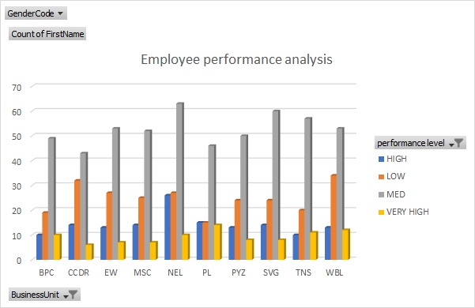
RESULT

Slide 14
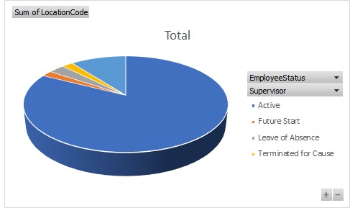

Slide 15
CONCLUSION
Employee performance analysis using Excel offers a flexible & powerful solution to all problem like Organization assess , Improve employee productivity & effectiveness. Excel creates a wide range if features such as Data analysis tool, Visualization and atomisation options makes it to a valuable tool for tiring raw performance data into actionable insights

